Slide 1

Finding the ideal location for a Vietnamese Restaurant in Waltham Forest

Slide 2
Introduction
This presentation aims to help a prospective restaurateur find the ideal location for developing a new Vietnamese restaurant in Waltham Forest.
Waltham Forest could be selected because it is convenient for the restaurateur, or because of it's proximity to the Olympic park, as well as rail links to both central and north London and areas.
Finding the right location is an important issue. Building in a place with too many competing Vietnamese Restaurants, or in the middle of an industrial park, would reduce the number of customers, and thus profits.

Slide 3
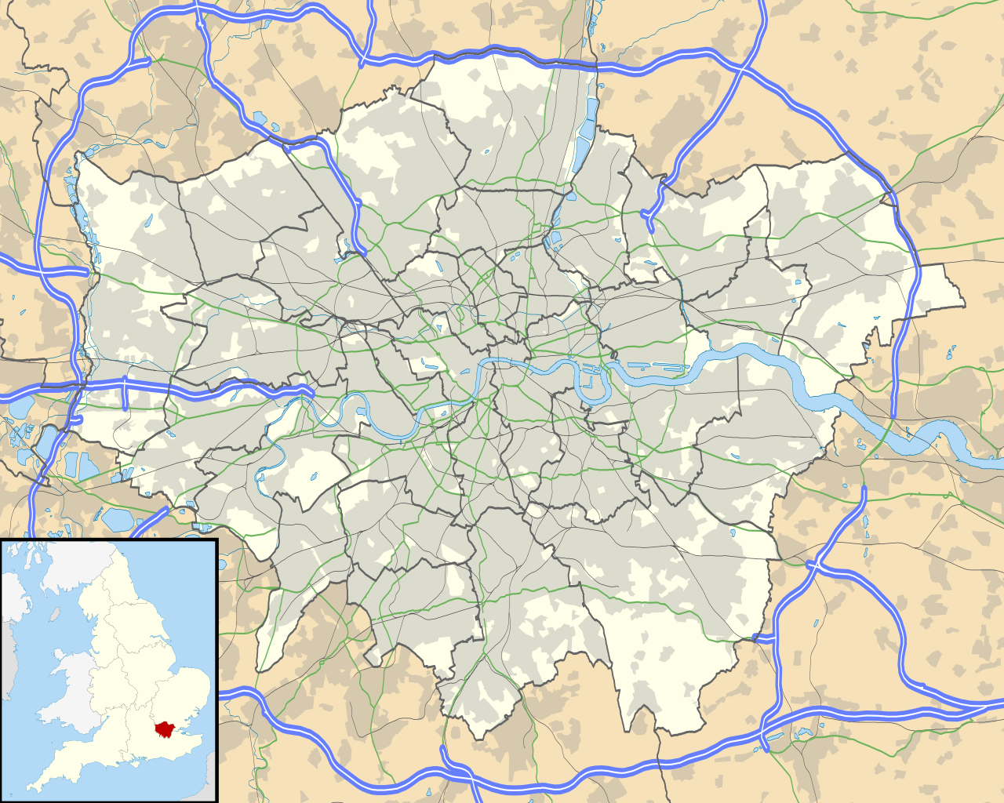

Data Usage
The geographical data will be scraped from the Wikipedia list of areas in London at https://en.wikipedia.org/wiki/List_of_areas_of_London
For each of these areas, a list of nearby venues will be found using FourSquare. This will be used to avoid competing Vietnamese restaurants, and find areas popular with diners.

Slide 4
Data Exploration
The intended method were first used on a smaller subset of the data to test that it work as intended.
The first observation was that FourSquare could not find all of the locations from the Wikipedia list of areas. However, the remaining sample was still very large and not systematically affected, so it was not considered an issue.
The second observation was that FourSquare returned too precise venue types, differentiating between styles of restaurant for example. Thus, the venue types were categorised.

Slide 5
Techniques used
In the final process, the London locations were scraped from Wikipedia, and then FourSquare was used to get a list of nearby venues for each location.
The venue types were grouped, and merged, giving a number of each type of venue nearby each location. This was divided by the sum of nearby venues to instead be the proportion.
K-means clustering was applied to the final dataframe, which consisted of a list of locations and the proportions of venue types nearby.

Slide 6
Results
Of the 6 clusters generated by K-means clustering, 2 has high proportions of Restaurants, so were good for the new development.
Of the locations in Waltham Forest, there were 5 in these two clusters.
However, checking to see whether there were nearby Vietnamese restaurants, 2 of these locations were rules out.

Slide 7
Conclusions
The remaining locations were Walthamstow, Walthamstow Village, and Leytonstone.
Thus, these are the recommended locations to investigate as potential sites for developing a new Vietnamese restaurant.
If a more precise recommendation is required, it is recommended that a more granular set of locations in Waltham Forest is found, so that each of these locations can be analysed using the developed model to determine its suitability.

